Slide 1
Database
QSG-Manager
UDP/IPC [ Gateway GPS + data flow message]
Message splitter
Display Webpage
update
Map Panel back-End Server
Map panel to show gateway device topographic communication situation

Slide 2
Database
QSG-Manager
HTTP GET request [ Gateway GPS + data flow message]
Message splitter
Display Webpage
update
Map Panel back-End Server
Map panel to show gateway device topographic communication situation
Notes:
Updated using http GET request (socketIO library)

Slide 3
Database
QSG-Manager
Communication Data
[ Gateway GPS + data flow message]
Message splitter
Display Webpage
HTTP GET
request
Data-rate uptake
Filter Options
[From Users]
update
Map Panel back-End Server
Map panel to show gateway device topographic communication situation
Notes:
Added the option for users to set data-rate uptake and filter function

Slide 4
Flaskmap.py
Program init
Load configure
Communication Thread
Data fetch request
UDP client (loop)
QSG-Manager
Data message
Web-Browser
Webpage host
User’s setting
Update the data fetch request based on the user’s setting

Slide 5
Flaskmap.py
Program init
Load configure
Communication Thread
HTTP GET request
socketIO (Loop)
QSG-Manager
Data message
JSON
object
Web-Browser
Webpage host
Message Parsing
User’s setting
Update the data fetch request based on the user’s setting
Notes:
Updated using http GET request (socketIO library)

Slide 6
Flaskmap.py
Program init
Load configure
Communication Thread
Database
HTTP GET request
socketIO (Loop)
QSG-Manager
Data message
JSON
object
Web-Browser
Webpage host
Message Parsing
User’s setting
Update the data fetch request based on the user’s setting
Notes:
Include database retrieval for QSG-Manager

Slide 7
Flaskmap.py
Program init
Load configure
Communication Thread
Database
HTTP GET request
socketIO (Loop)
QSG-Manager
Data message
JSON
object
Web-Browser
Webpage host
Message Parsing
User’s setting
Update the data fetch request based on the user’s setting
Notes:
Include database retrieval for QSG-Manager

Slide 8

topologyMapHost.py
databaseCreater.py
Program init
Program init
Load node data
Load configure
Create random node state data
Data Manager Thread
Data Mgr (Loop)
Data Fetching
Database
Node data
JSON
object
Web-Browser
Webpage host
Message Parsing
Create Node, comm-link Json
User’s setting
Update the data fetch request based on the user’s setting
Notes:
Include database retrieval for QSG-Manager

Slide 9
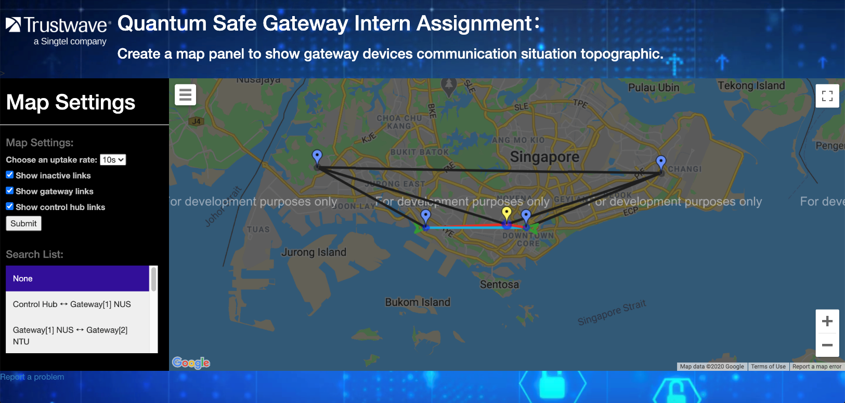
2
1
User Interface Component
1
Topological Map:
Display device communication links
2
Collapsible Sidebar:
Allows users to set the map settings
Notes:
Topological Map setup user interface

Slide 10
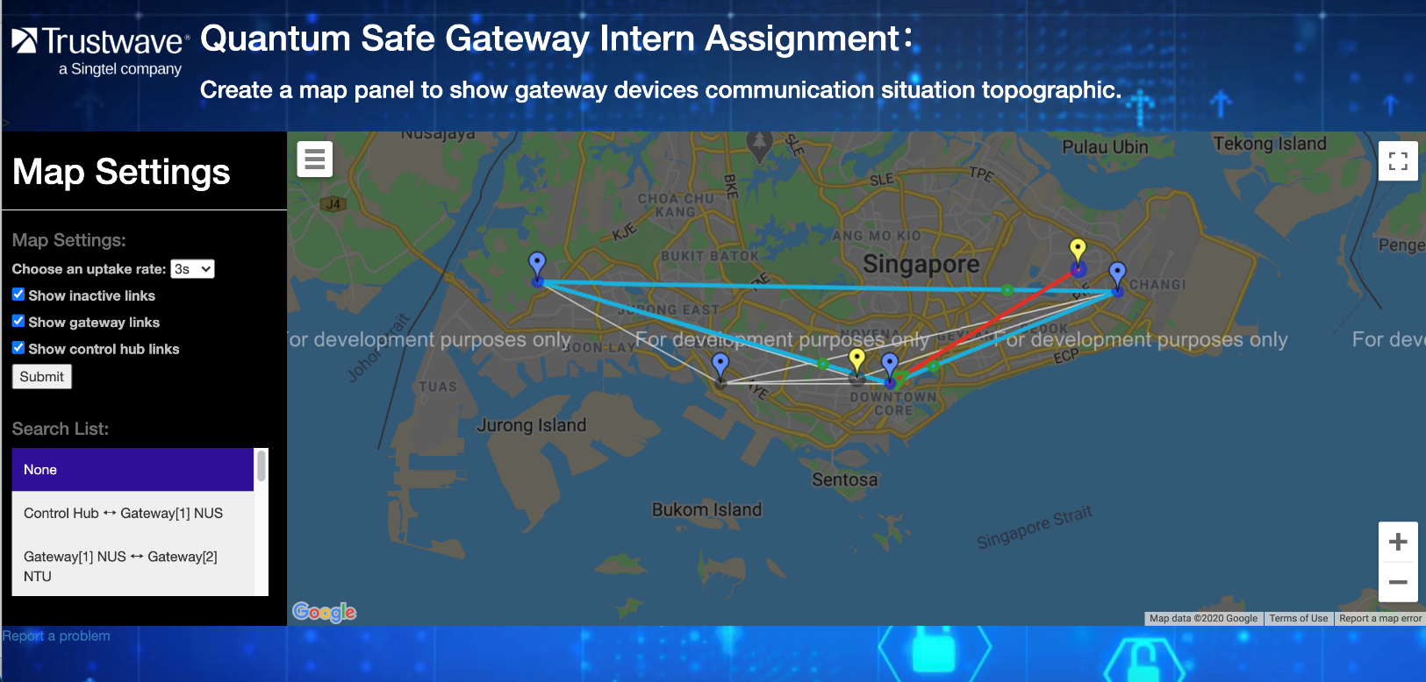
2
1
User Interface Component
1
Topological Map:
Display device communication links
2
Collapsible Sidebar:
Allows users to set the map settings
Notes:
Topological Map with updated polyline UI interface

Slide 11
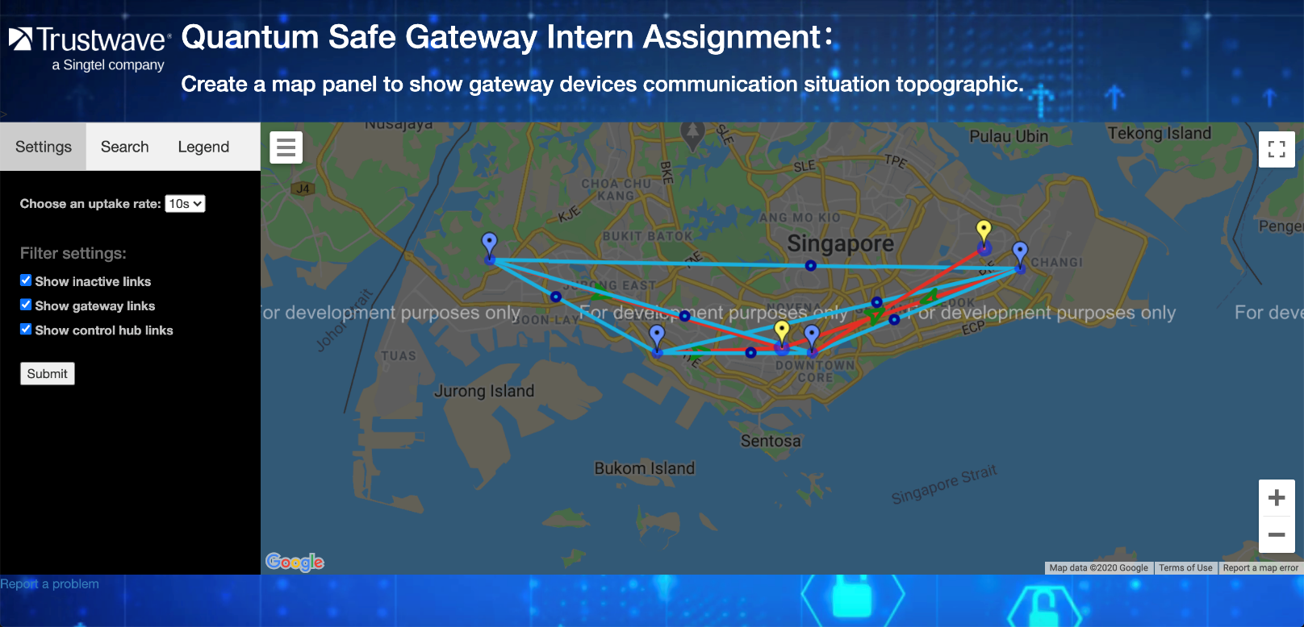
2
1
User Interface Component
1
Topological Map:
Display device communication links
2
Collapsible Sidebar:
Multiple tabs with map settings, search function and legend
Notes:
Topological Map with updated sidebar UI

Slide 12
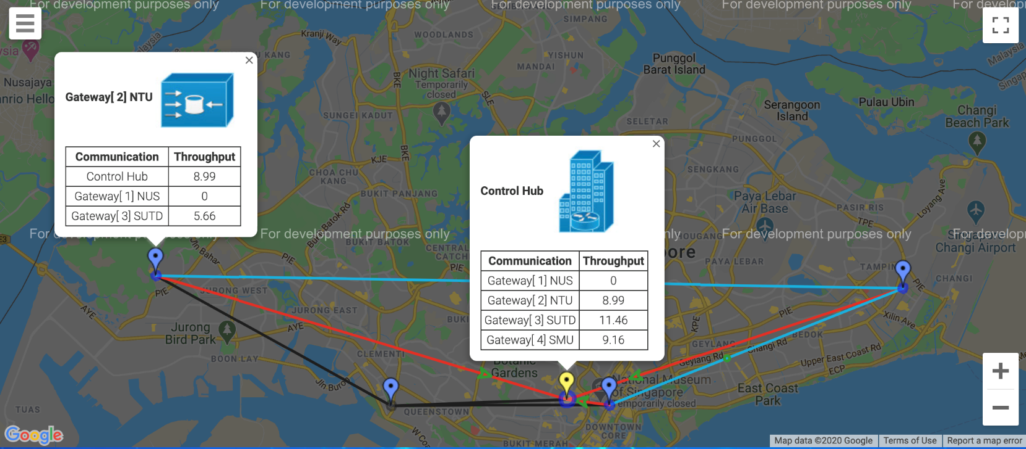
Marker Components
4
1
Control Hub Marker:
Shows location of control hub
3
Gateway Marker:
Shows location of gateway
2
3
Control hub info window:
Throughput information of control hub
4
Gateway info window:
Throughput information of gateway
2
1
Notes:
Marker components

Slide 13
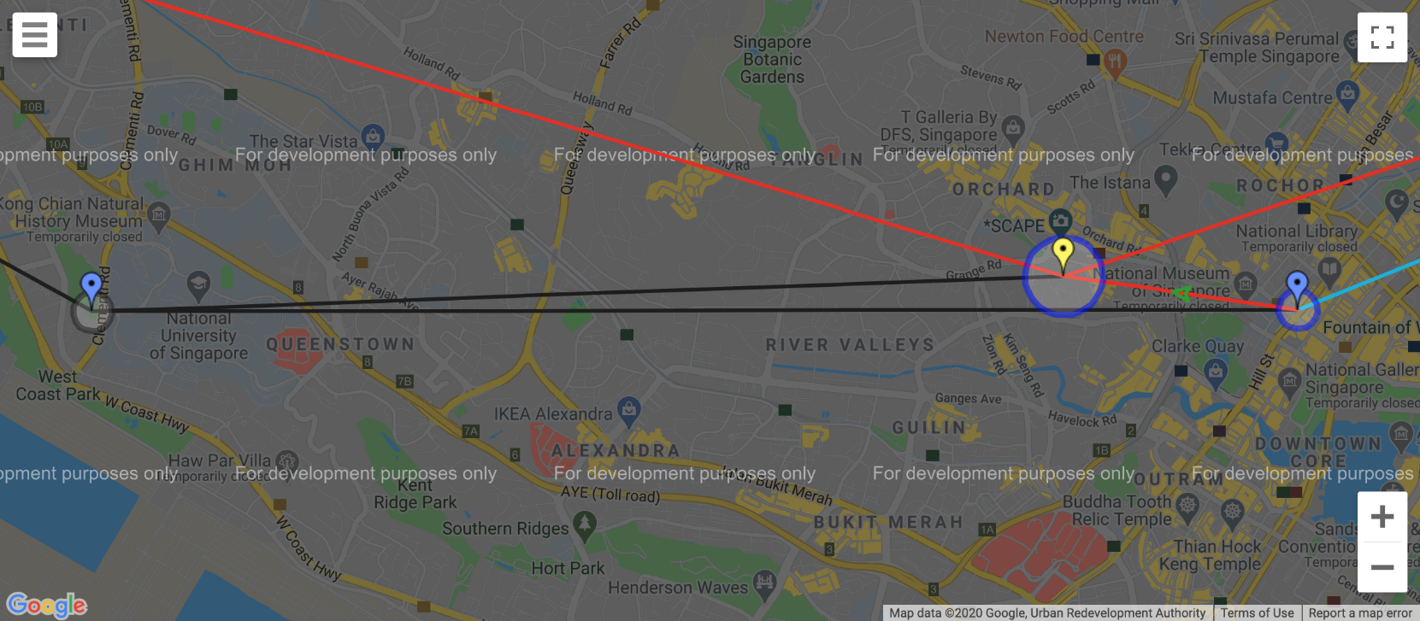
Activation Circle Components
1
1
Active Activation Circle:
Display in blue to show active communication of 2 devices
2
2
Inactive Activation Circle:
Display in grey to show inactive communication of 2 devices
Notes:
Activation circle components

Slide 14
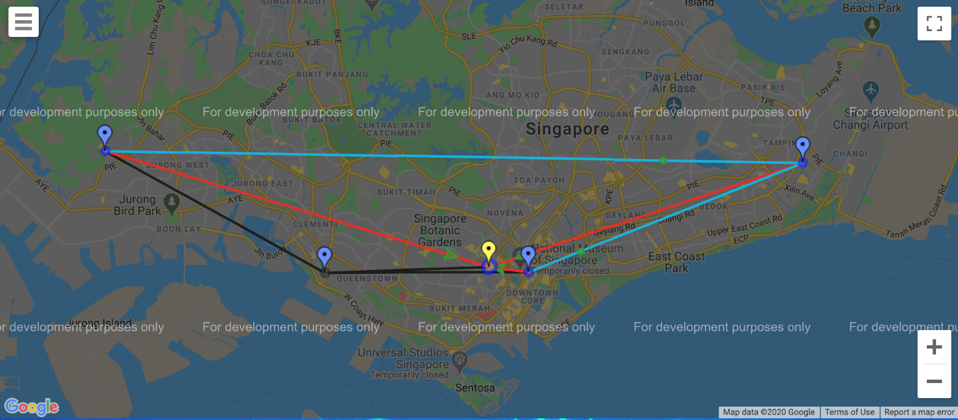
Communication Link Components
1
Control Hub Comm Link:
Display in blue to show active communication of 2 devices
2
1
2
Gateway Comm Link:
Display in grey to show inactive communication of 2 devices
3
2
Inactive Comm Link:
Display in grey to show inactive communication of 2 devices
Notes:
Communication links component

Slide 15
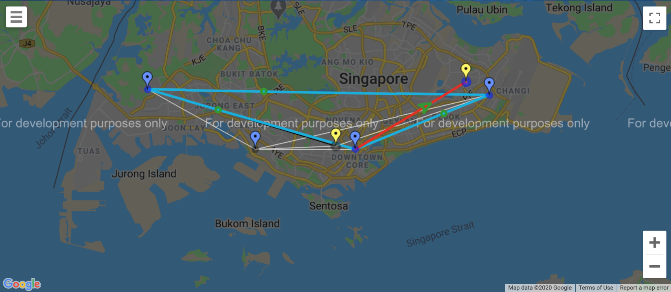
Communication Link Components
1
Control Hub Comm Link:
Display in Red to show active communication of Control Hub
2
1
2
Gateway Comm Link:
Display in Blue to show active communication of 2 devices
4
3
3
Black Comm Link:
Represents 2 gateway which has done key exchange but inactive
4
Grey Hub Comm Link:
Represents 2 gateway that are inactive and no key exchange
Notes:
Update communication link components
\

Slide 16

Animated Symbols Component
2
Green Forward Arrowhead:
Represent Gateway to Control Hub comm. One-way data traffic
1
1
2
Dark Blue Circle:
Represent Gateway to Gateway comm. Two-way data traffic
Notes:
Animated symbols component

Slide 17

Map Settings Component:
1
1
Rate-Uptake Settings:
Set frequency of GET request from server to QSG-Manager
2
2
Map Filter Settings:
Display/Hide certain communication links
Notes:
Map settings component

Slide 18
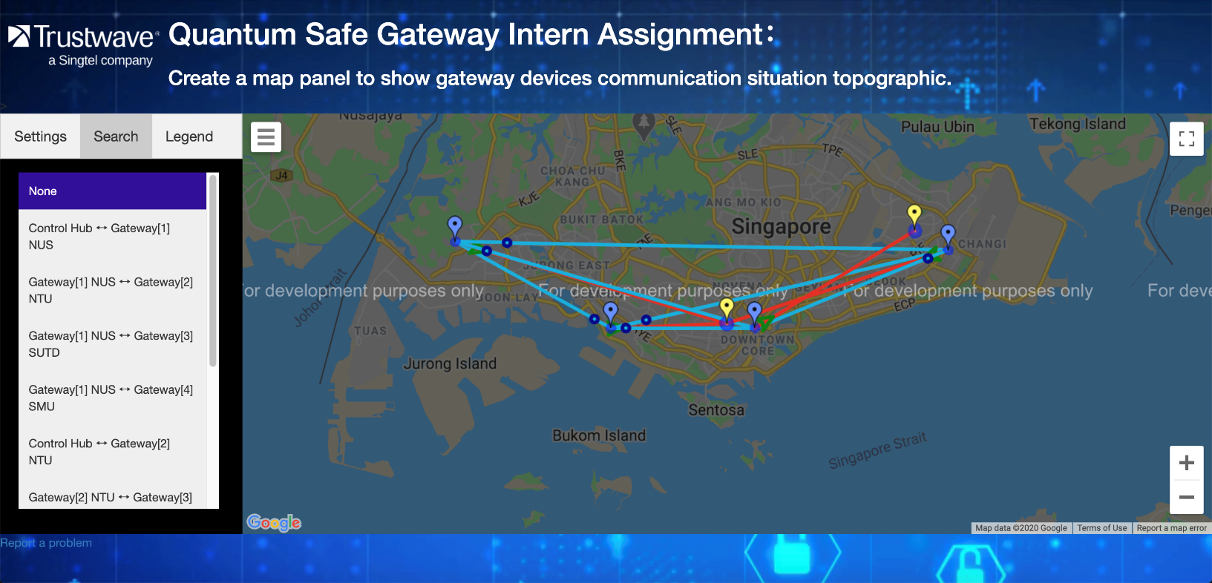
1
Search Components:
1
Search List:
Highlight a specific communication link on the map
Notes:
Search list component

Slide 19
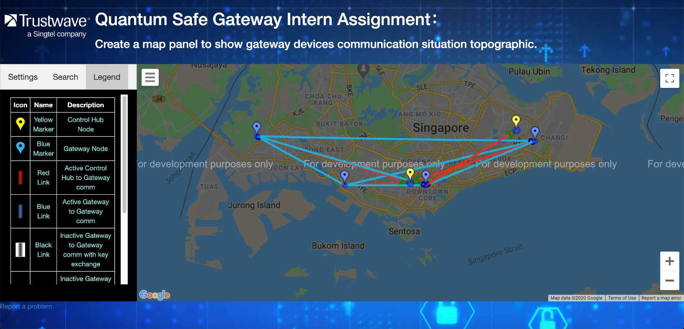
1
Legend Components:
1
Legend Table:
Provide details of the components in the map
Notes:
Legend components

Slide 20
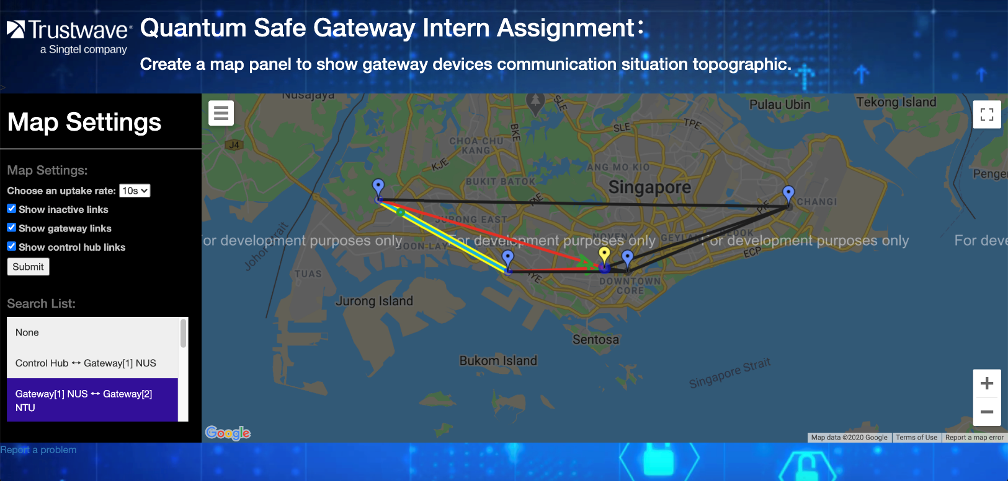
Sidebar Component
1
Rate-Uptake Settings:
Set frequency of GET request from server to QSG-Manager
1
2
2
Map Filter Settings:
Display/Hide certain communication links
3
3
3
Search List:
Highlight a specific communication link on the map
Notes:
June project progress

Slide 21
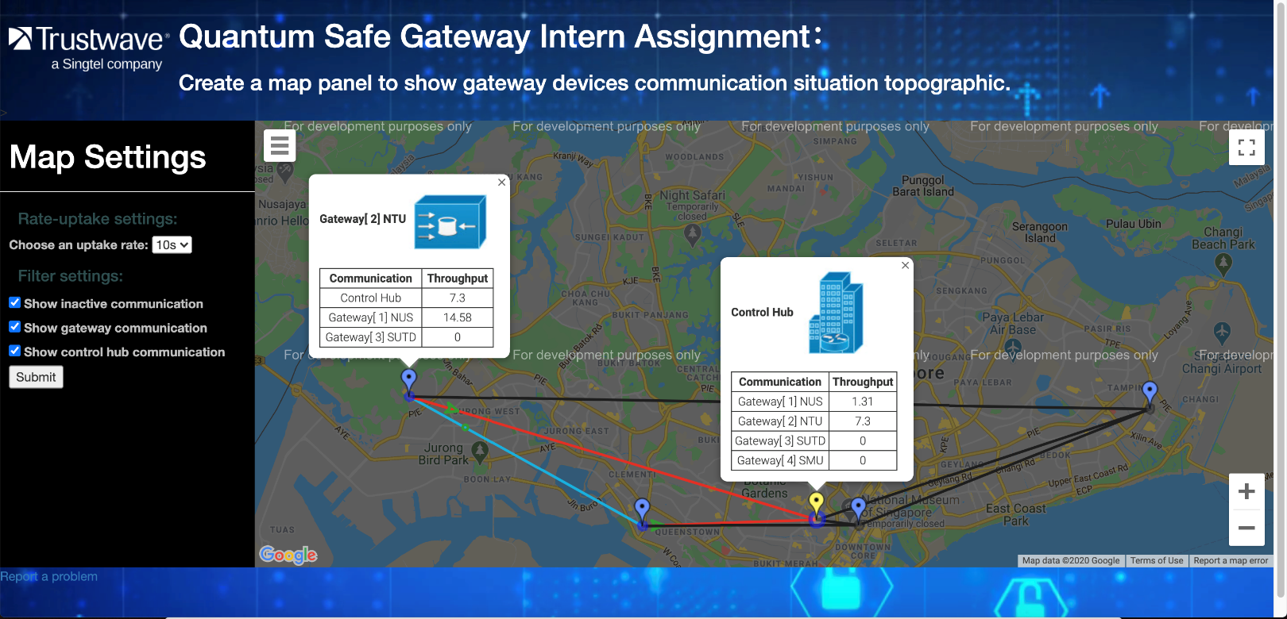
1
1
Topological Map Sidebar:
Collapsible sidebar allowing users to set map settings
2
3
2
Marker Info Window
Display the throughput information of markers
2
4
3
Rate-Uptake Settings:
Set frequency of GET request from web server to QSG-Manager
4
Map Filter Settings:
Display/Hide certain communication links
Notes:
June project progress

Slide 22
1
July Project Progress
1
Topological Map:
Modify the UI with different types of communication links
2
2
Search list table:
Allow users to highlight a specific communication
Notes:
July Progress Report

Slide 23
Notes:
Web application legend symbols

